Slide 1
LDA Analysis
0856156 Huong Vu

Slide 2
Description
Based on the given results of web crawling, perform LDA Analysis

Slide 3
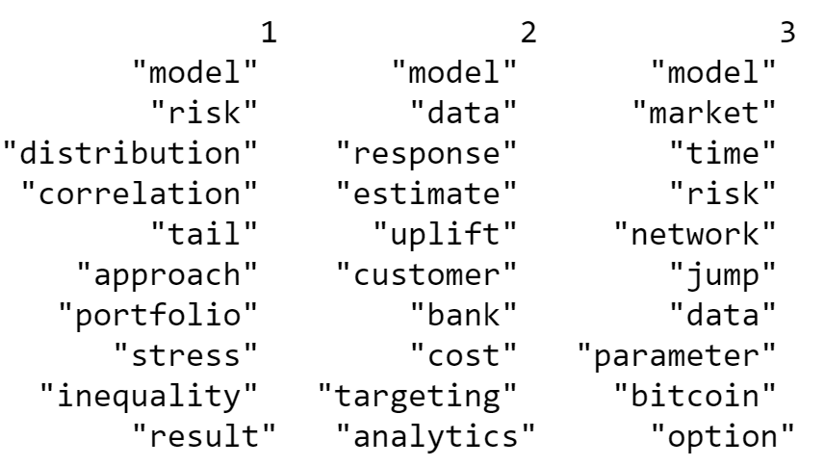
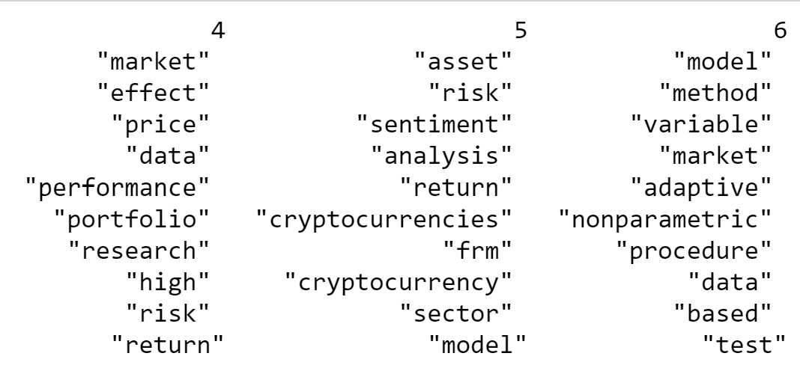
Results
The number of topics assigned to the LDA model: K =6
Suitable topics by observing the heatmap:
Risk modelling
Models to evaluate target customer response
Risk modelling in Bitcoin market
Research on market risk
Models to analyze the cryptocurrencies
Modelling process and methods
TOPICS KEYWORS:

